Slide 1

UI/UX CASE STUDY 1
Jamhuriya University App
Evaluating a local application: features, design and user experience
Group members
Sabir Abukar Abdikadir (C1230785)
Hassan Abdirahin Abshir (C1230866)
Abdikani Mohamud Nur (C1230893)
Abdirizak Tahlil Mohamoud C1230098

Slide 2
Business Overview
Jamhuriya University of Science and Technology (JUST)
2011
Mogadishu
Private
Science & Tech
Somali scholars
Year it started
Location, Somalia
Type of university
Main focus
Who founded it
Purpose: to give higher education that meets international standards.
Jamhuriya University App | UI/UX Case Study 1
2

Slide 3
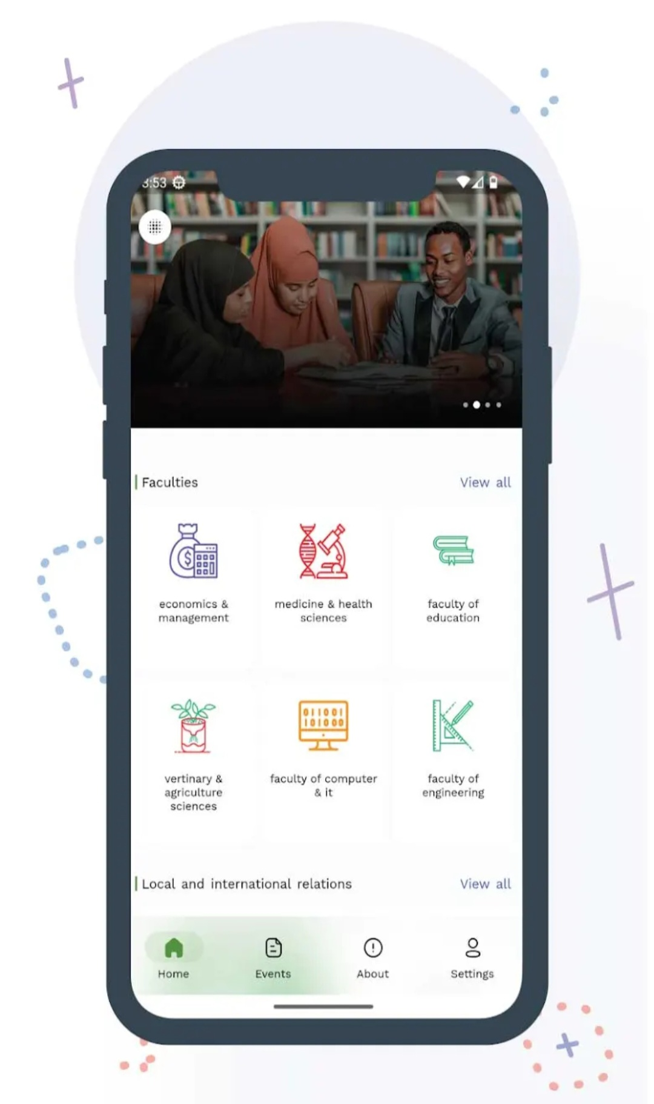
What Is the App?
JUST Mobile: Jamhuriya Official App
A guide for students who want to study at JUST and for students who study there now.
What it gives users
The latest updates, events, exam results and notices in one place.
Quick facts
Released Dec 2020 | 10k+ downloads | Rating 4.7 on Google Play
Jamhuriya University App | UI/UX Case Study 1
3

Slide 4
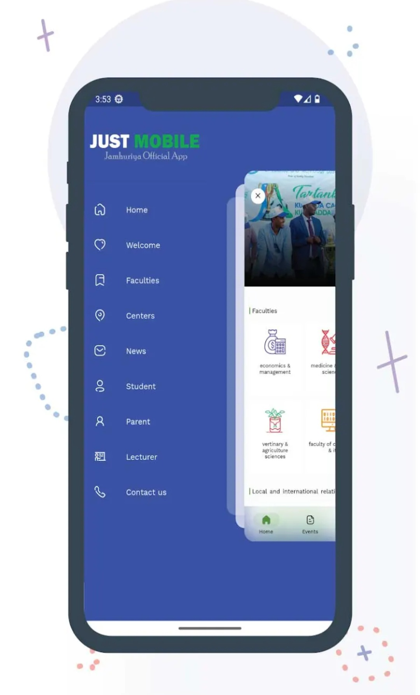
Who Uses It and How It Helps
Students
See schedule, exams, attendance and fees on the phone.
Parents
Follow their child's progress without going to campus.
Lecturers
Get news and notices in one place.
New students
Explore faculties and programs before they join.
Jamhuriya University App | UI/UX Case Study 1
4

Slide 5
Target Audience and Main Goals
1
2
3
Current JUST students
Check classes, exams and news every day.
Future students
Learn about faculties and programs before joining.
Parents
Stay informed about their child's studies.
Main goals of the app
Easy access to information
Save time and travel
Keep parents informed
Share news and events
Jamhuriya University App | UI/UX Case Study 1
5

Slide 6
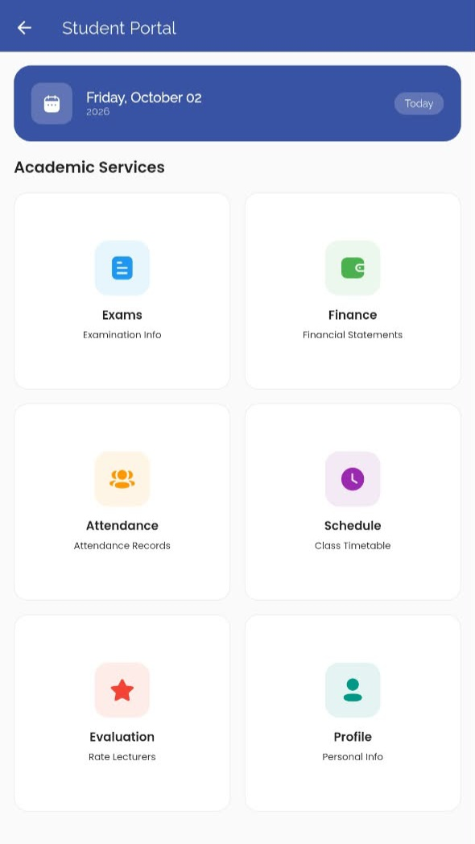
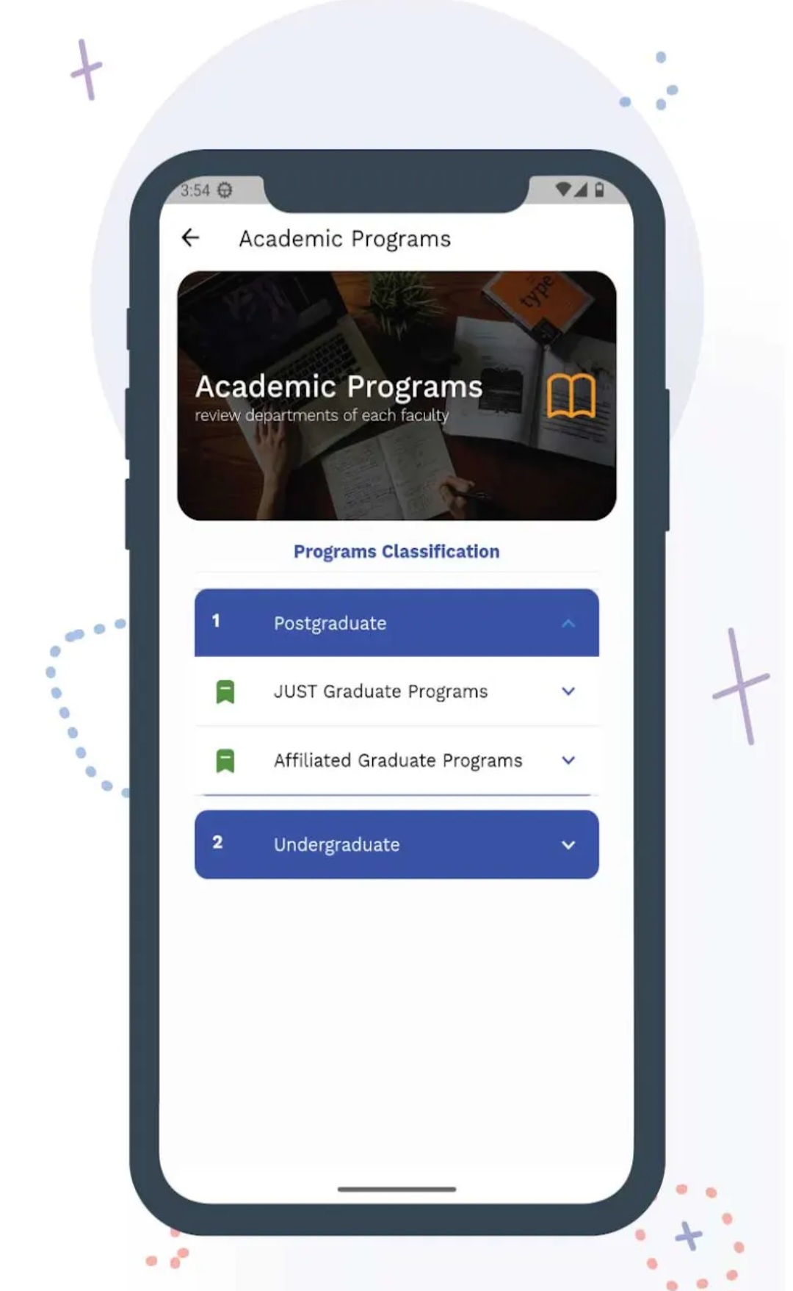
Design Overview
Blue
Headers, menus and buttons
Green
Icons and the active tab
White
Clean, simple background
Icons
Simple line icons with short labels, one for each faculty.
Layout
Cards in a grid, a side menu and four tabs at the bottom.
Jamhuriya University App | UI/UX Case Study 1
6

Slide 7
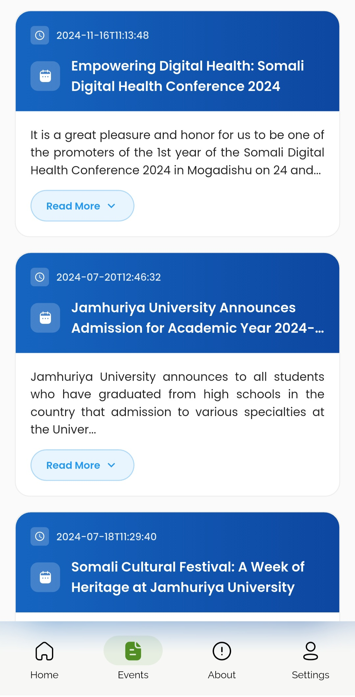
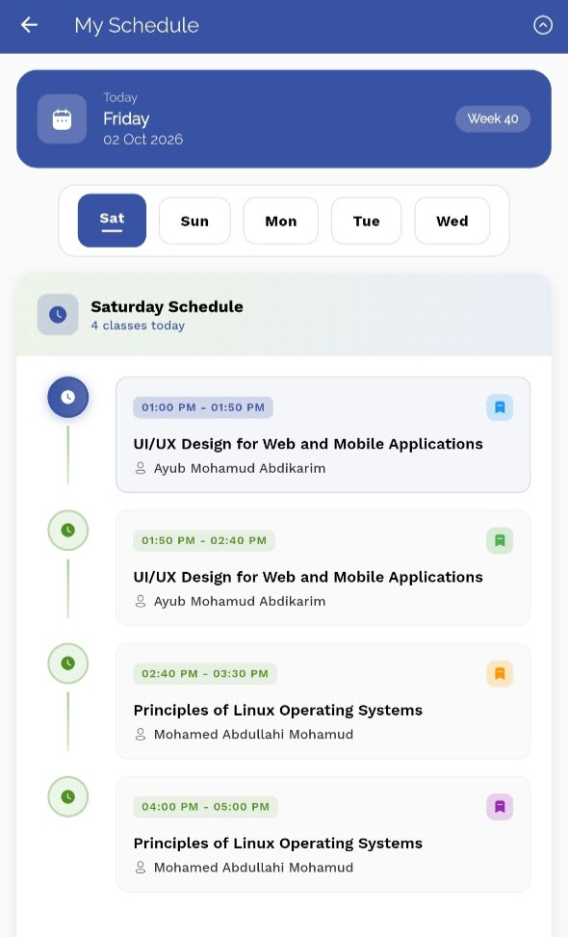
Key Features
Also inside
Faculties
Programs
Centers
News
Welcome
About
Contact us
Dark mode
Student Portal
Exams, Finance, Attendance, Schedule, Evaluation, Profile
Events
News and announcements with a Read More button
My Schedule
Daily classes with time and lecturer name
Jamhuriya University App | UI/UX Case Study 1
7

Slide 8
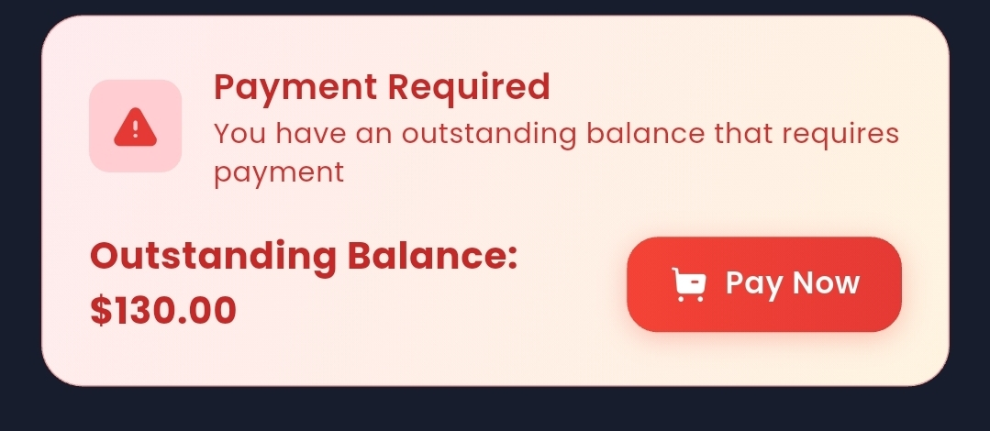
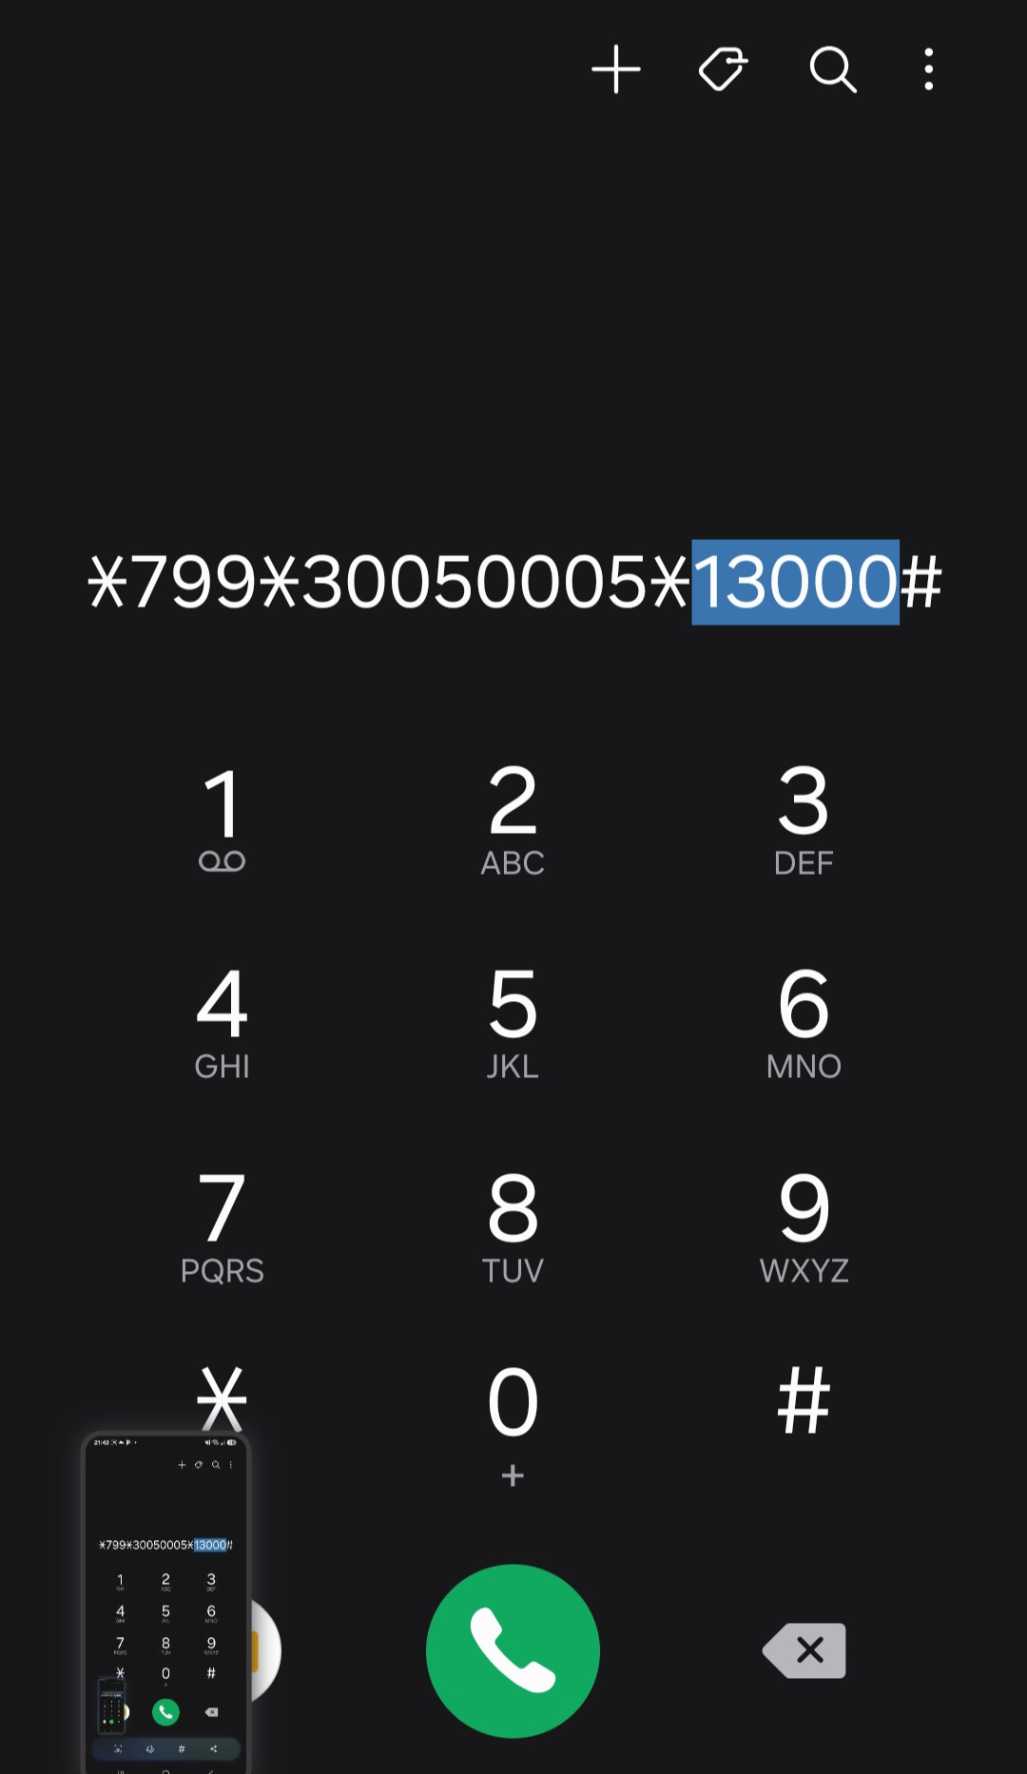
Missing Features (1 of 2)
1. No current events
Latest events are from 2024. Add JUSA Day, IT Day, seminars and an Announcements page.
2. No push notifications
Holidays, events and absences are sent on WhatsApp. The app should send them.
3. Payment bug
130.00 goes to the phone dialer as 13000. Users may think the amount is much bigger.
4. No search
Users cannot search for courses, news or events.
Jamhuriya University App | UI/UX Case Study 1
8

Slide 9
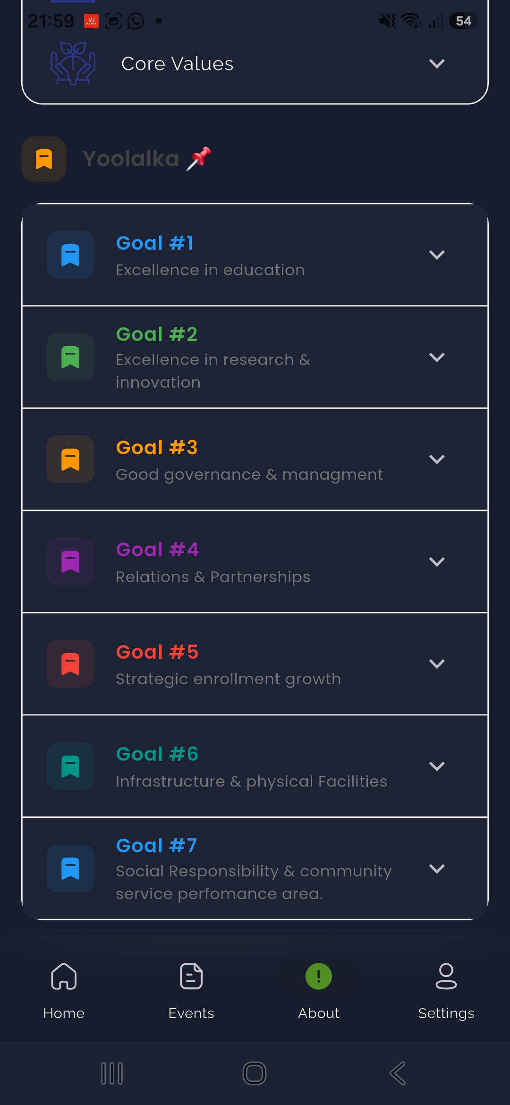
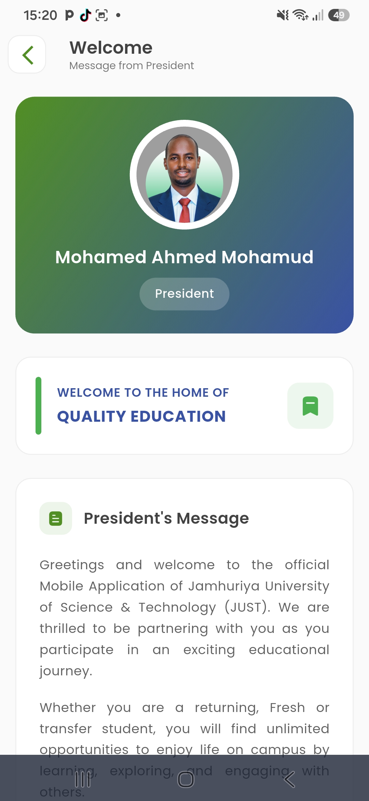
Missing Features (2 of 2)
5. Dark mode is not finished
The Welcome page stays white. On About, text and background do not match well.
6. No lecturer contact
Schedule shows time, course and lecturer, but no call or message button.
7. Logout has no warning
One tap logs the user out. It needs "Are you sure? Yes / Cancel".
8. Slow login
Users type ID and password each time. Add saved account, passcode or fingerprint.
Jamhuriya University App | UI/UX Case Study 1
9

Slide 10
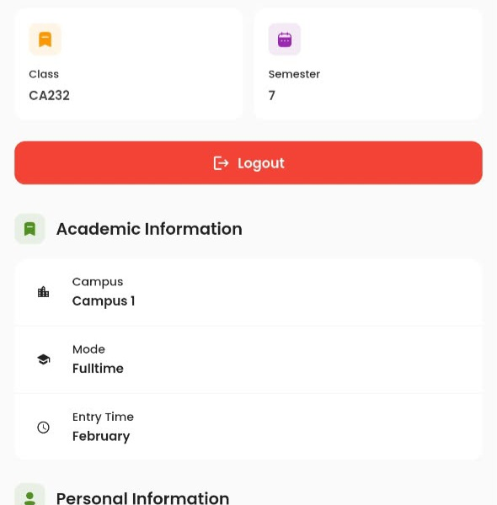
Logout Needs a Warning
The problem
The red Logout button logs the user out with one tap. There is no warning.
Why it matters
A student can tap it by mistake and must sign in again with ID and password.
Our suggestion
Ask first with Yes and Cancel. Add fingerprint login for fast sign-in.
Are you sure you want to log out?
Cancel
Yes, log out
Jamhuriya University App | UI/UX Case Study 1
10

Slide 11
Recommendations for Improvement
Fix the payment amount
Send 130 and show a check screen first.
Add push notifications
Events, absences, holidays and attendance.
Keep events current
Add JUSA Day, IT Day and seminars on time.
Add a search bar
Find courses, news and events fast.
Finish dark mode
Every page should follow the same mode.
Safer login and logout
Ask before logout. Add fingerprint login.
Add lecturer contact
A call or message button on the schedule.
Clean up text and dates
Left-aligned text, dates like 16 Nov 2024, fix typos.
Jamhuriya University App | UI/UX Case Study 1
11

Slide 12
Summary and Predictions
What we found
Good: clean menus, clear icons, blue and green fit the university.
Needs work: old events, no notifications, payment bug, unfinished dark mode.
What we predict
A good UI/UX team makes the app easier to use and nicer to look at.
Fixing small details gives more trust, more daily use and happier students and parents.
Good design = easy to use + nice to look at
Jamhuriya University App | UI/UX Case Study 1
12

Slide 13
ONE QUESTION FOR YOU
If you could add ONE feature to the Jamhuriya University App, what would it be?
Thank you!

